Slide 1
MACHINE LEARNING
UNIT-1
Binary Classification
and
Related Tasks

Slide 2
Topics
Classification
Scoring and Ranking
Class Probability Estimation

Slide 3
Classification—A Two-Step Process
Model construction: describing a set of predetermined classes
Each tuple/sample is assumed to belong to a predefined class, as determined by the class label attribute
The set of tuples used for model construction is training set
The model is represented as classification rules, decision trees, or mathematical formulae
Model usage: for classifying future or unknown objects
Estimate accuracy of the model
The known label of test sample is compared with the classified result from the model
Accuracy rate is the percentage of test set samples that are correctly classified by the model
Test set is independent of training set (otherwise overfitting)
If the accuracy is acceptable, use the model to classify new data
Note: If the test set is used to select models, it is called validation (test) set

Slide 4
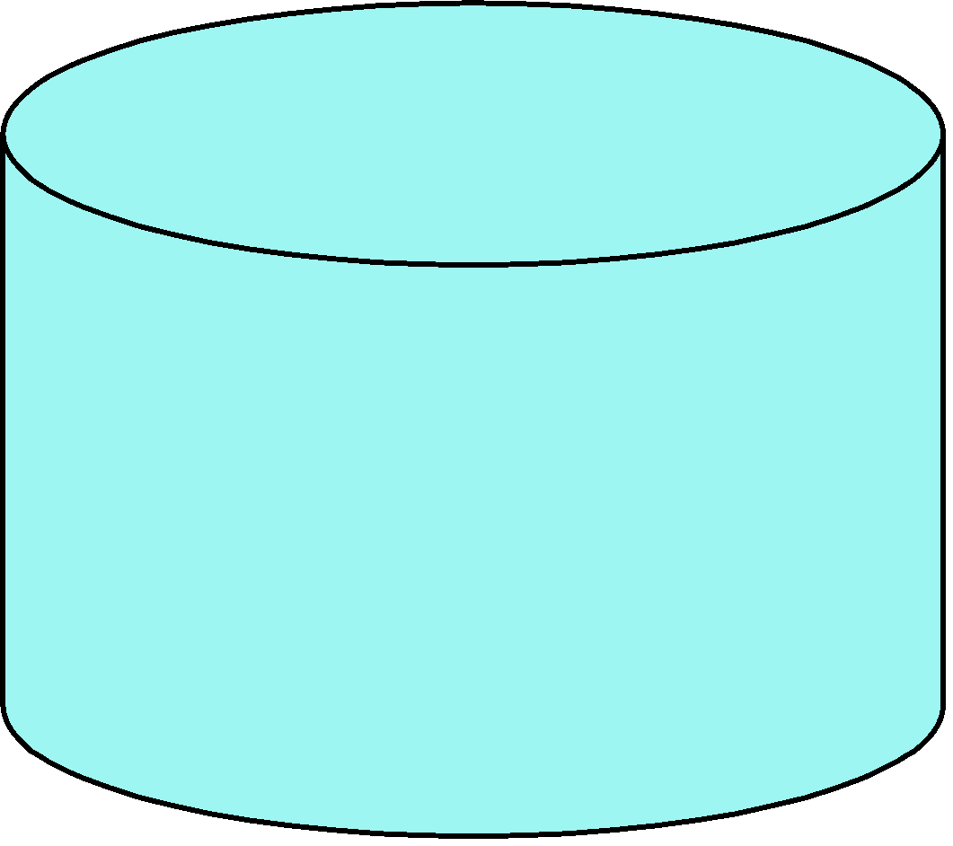
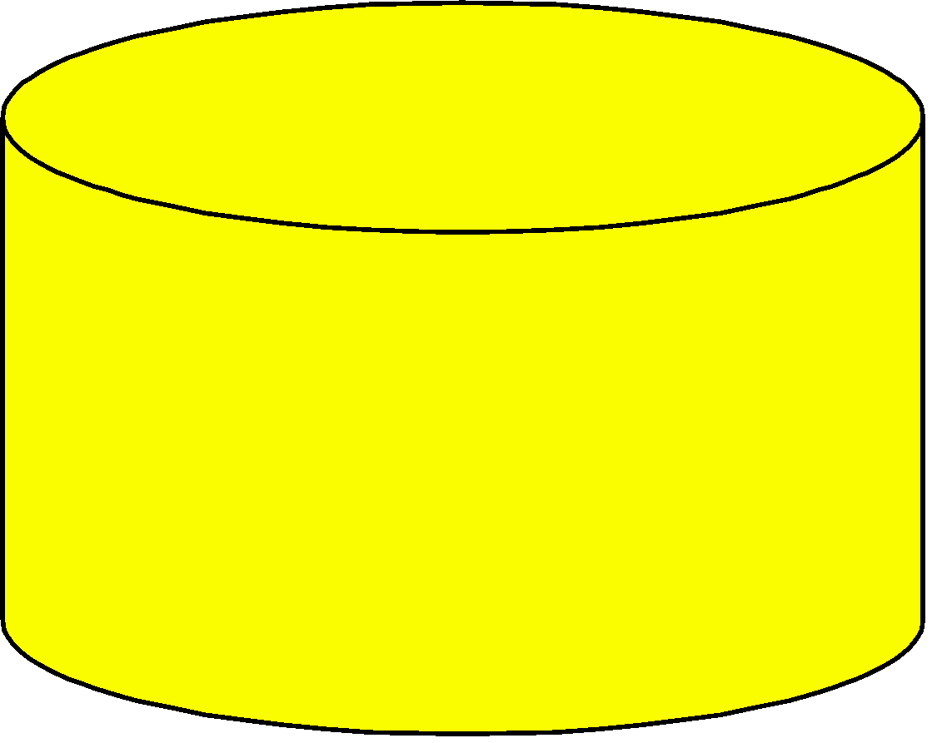
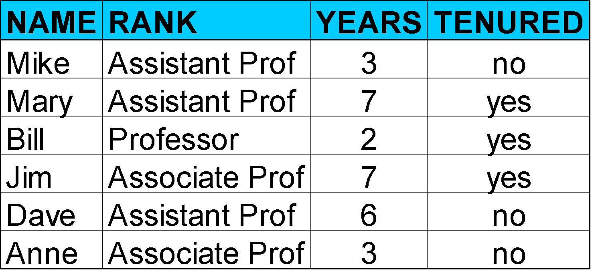
Process (1): Model Construction
Classification
Algorithms
Training
Data
Classifier
(Model)

Slide 5
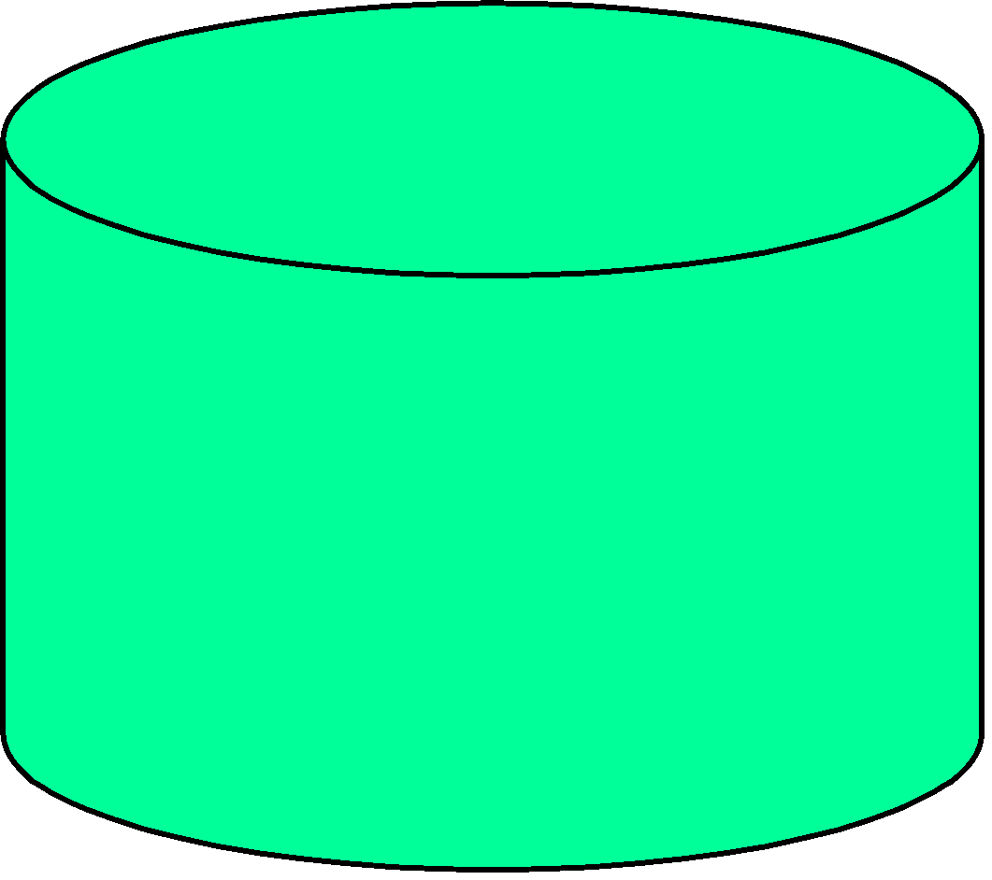


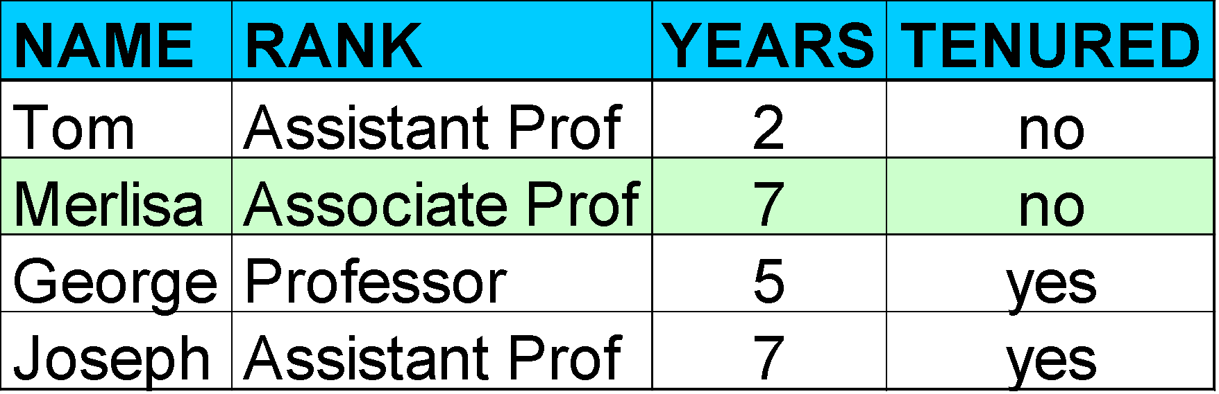
Process (2): Using the Model in Prediction
Classifier
Testing
Data
Unseen Data
(Jeff, Professor, 4)
Tenured?

Slide 6


Classification
Classification is the most common task in machine learning.
Mapping from Instance space“ “ to a class label of different classes.
If only two classes are existed then it is called as binary classification.
Positive + or Negative –
+1 or -1
Binary classification is also called as concept learning. Positive class is called as concept.

Slide 7
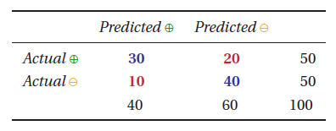
Assessing Classification Performance
Performance of classifier can be summarized using a table called contingency table or confusion matrix.
Row-Actual and Column-Predicted
Row and column sums are called marginals.
Predicted positive predicted negative
True Positive Model correctly Predicts the +ve class | False Negative Model in-correctly Predicts the +ve class
False Positive Model in-correctly Predicts the -ve class | True Negative Model correctly Predicts the -ve class
Actual Positive
Actual Negative
A
B
X Y

Slide 8
Metrics
Accuracy = TP+TN/(TP+FP+FN+TN)
Error rate=1-Accuracy
Precision(PPR) = TP/(TP+FP)
Recall (TPR)= TP/(TP+FN)
F1-Score = 2*(Recall * Precision) / (Recall + Precision)
Specificity(TNR)=TN/(TN+FP)
FPR=1-Specificity

Slide 9

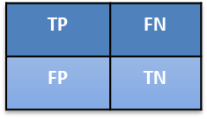
Metrics: Accuracy and Error rate
Accuracy = TP+TN/(TP+FP+FN+TN)
Here, the function I [·] denotes the indicator function, which is 1 if its argument evaluates to true, and 0 otherwise.
Alternatively, we can calculate the error rate as the proportion of incorrectly classified instances.
Clearly, accuracy and error rate sum to 1.

Slide 10
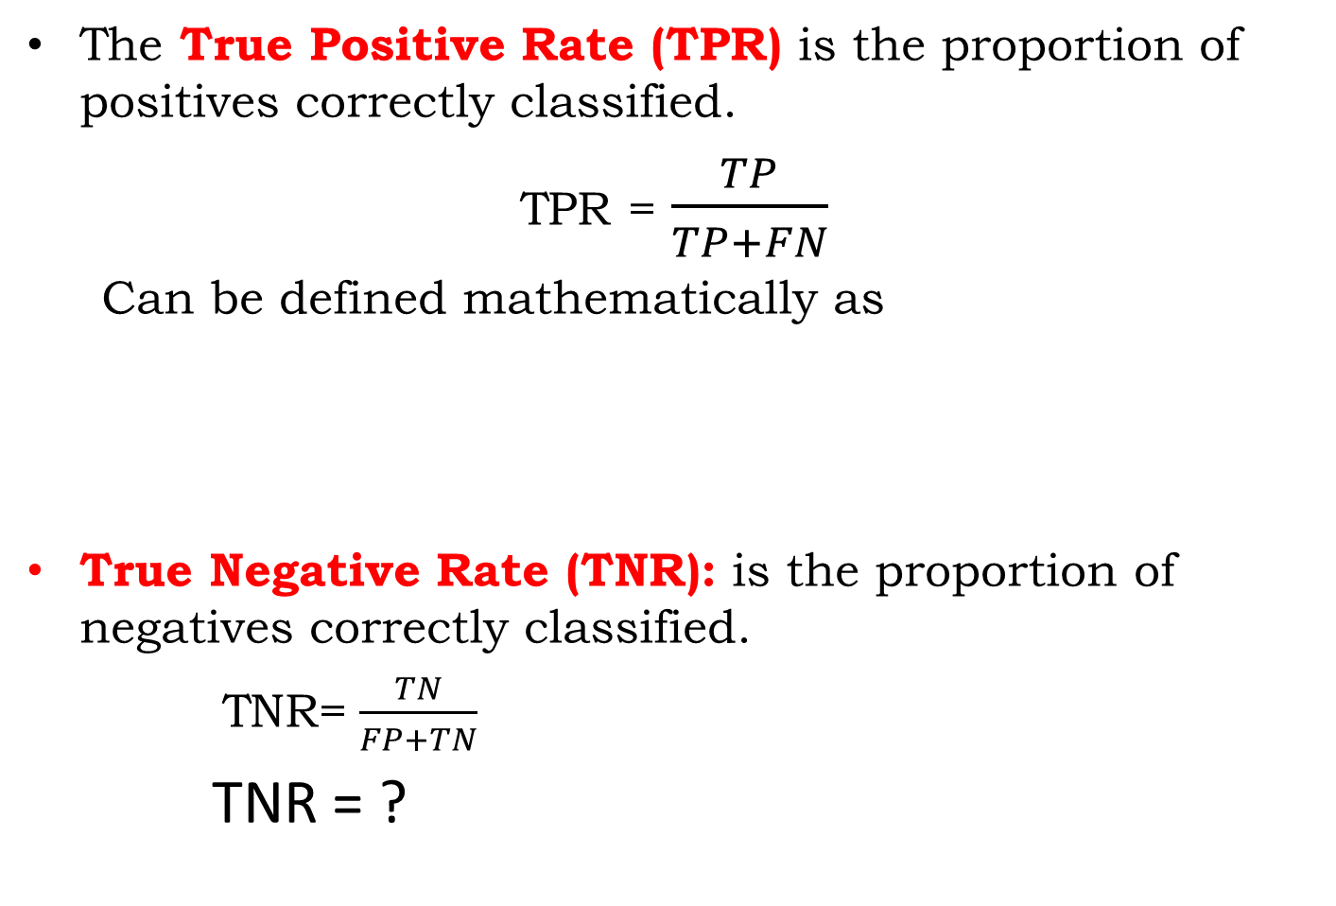


Metrics: Sensitivity and Specificity
TP | FN
FP | TN

Slide 11
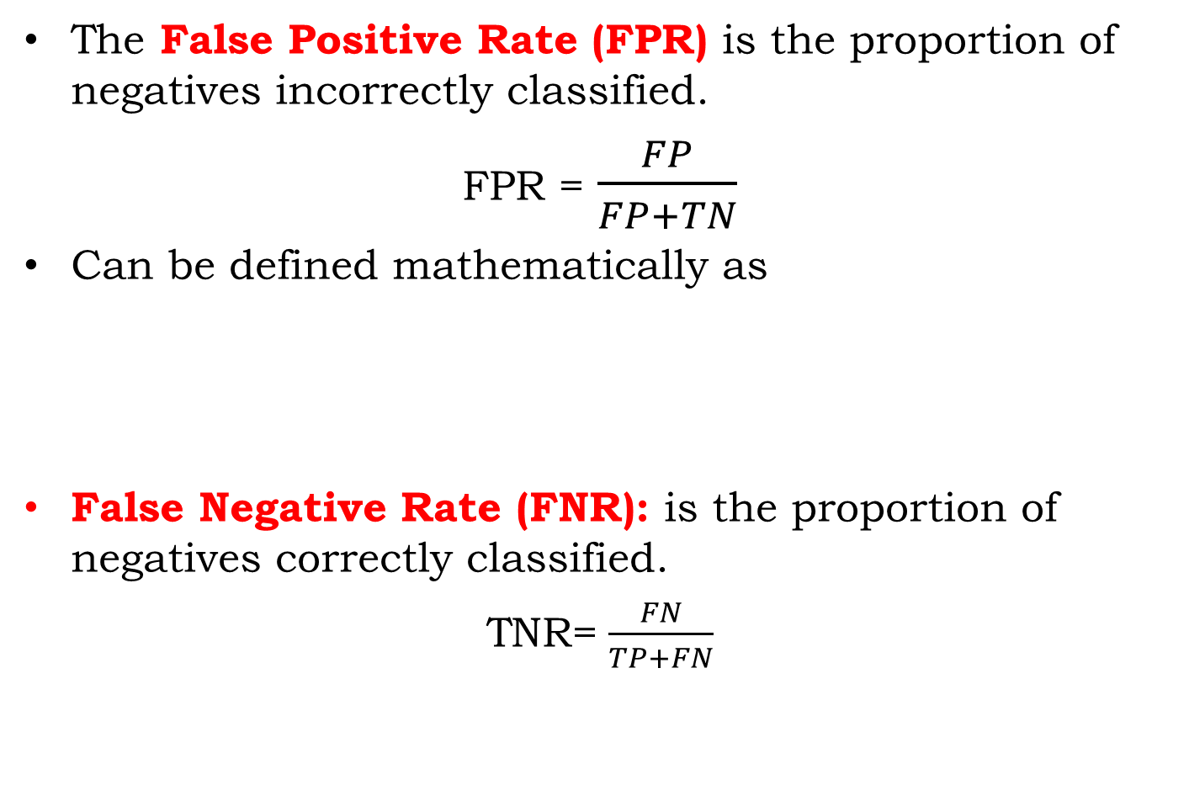
Metrics: Sensitivity and Specificity

Slide 12
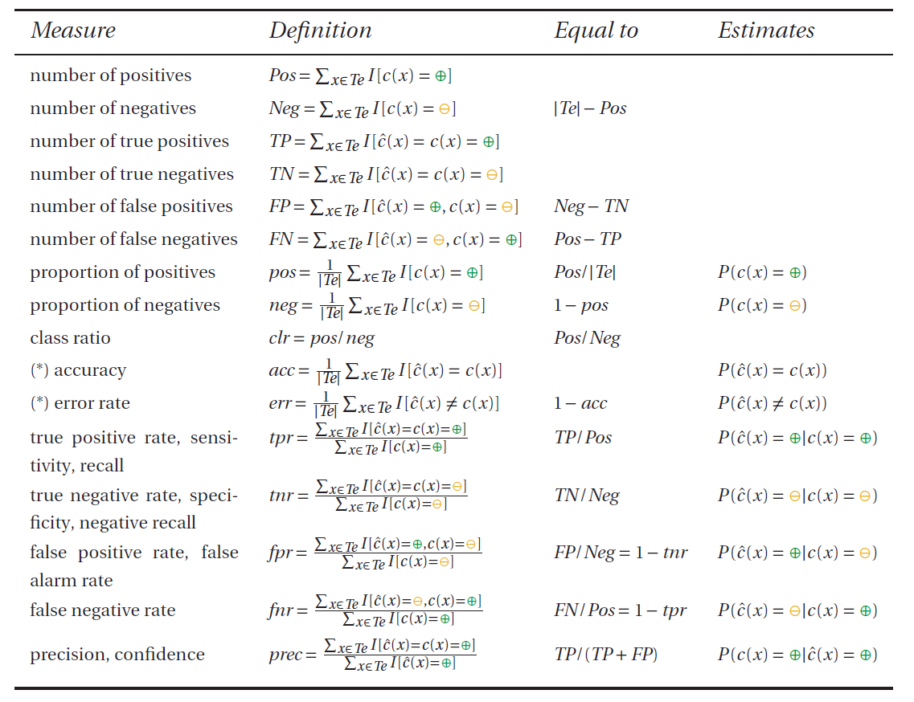
All Measures

Slide 13
All Measures

Slide 14
Coverage Plot
A coverage plot visualizes the
number of positives Pos,
number of negatives Neg,
number of true positives TP and
number of false positives FP.
by means of a rectangular coordinate system and a point.

Slide 15
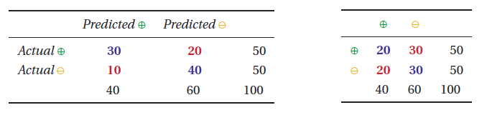
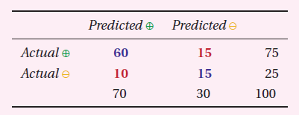
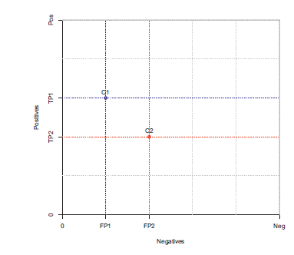
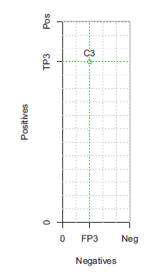
Visualize classification Performance: Coverage Plot
C1 is better than C2
C1 has More TP and Fewer FP as Compared with C2

Slide 16
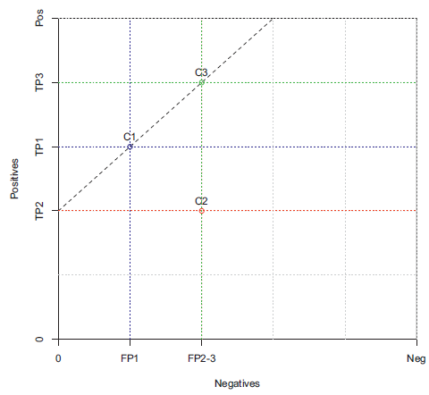
Coverage Plot
In a coverage plot, classifiers with the same accuracy are connected by line segments with slope 1.
Here C1 and C3 classifiers have same accuracy.
Choice between C1 and C3 is arbitrary; if true positives are more important we should choose C3, if false positives are more important we prefer C1.

Slide 17
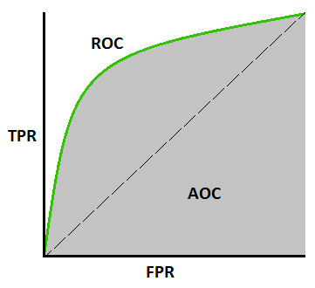
ROC Plot
ROC stands for receiver operating characteristic
AOC stands for Area Under the Curve
ROC plots are much more common than coverage plots, but both have their specific uses.
coverage plot is used if you are working with a single data set.
An ROC plot is useful if you want to combine results from different data sets with different class distributions.

Slide 18
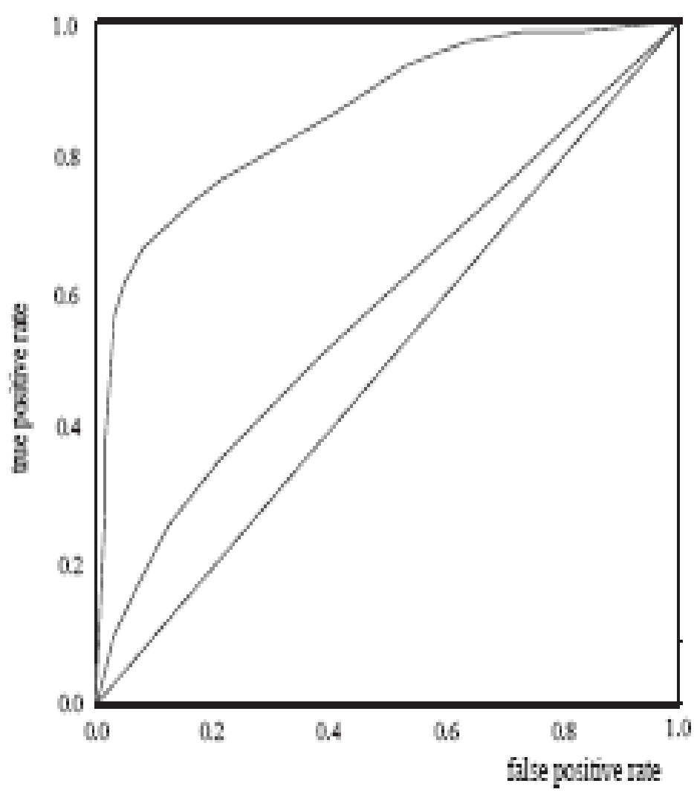
ROC PLOT
ROC (Receiver Operating Characteristics) curves: for visual comparison of classification models
Shows the trade-off between the true positive rate and the false positive rate
The area under the ROC curve is a measure of the accuracy of the model
Rank the test tuples in decreasing order: the one that is most likely to belong to the positive class appears at the top of the list
The closer to the diagonal line (i.e., the closer the area is to 0.5), the less accurate is the model
A model with perfect accuracy will have an area of 1.0

Slide 19
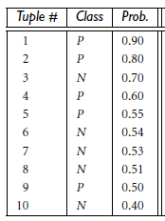
ROC PLOT Example
TP | FP | TN | FN | TPR | FPR
1 | 0 | 5 | 4
2 | 0 | 5 | 3
2 | 1 | 4 | 3
Actual Positive tuple P=5
Actual Negative tuples N=5

Slide 20
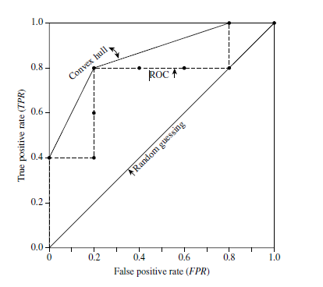
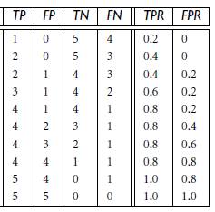
ROC PLOT Example
Actual Positive tuple P=5
Actual Negative tuples N=5

Slide 21
Topics
Classification
Scoring and Ranking
Class Probability Estimation

Slide 22

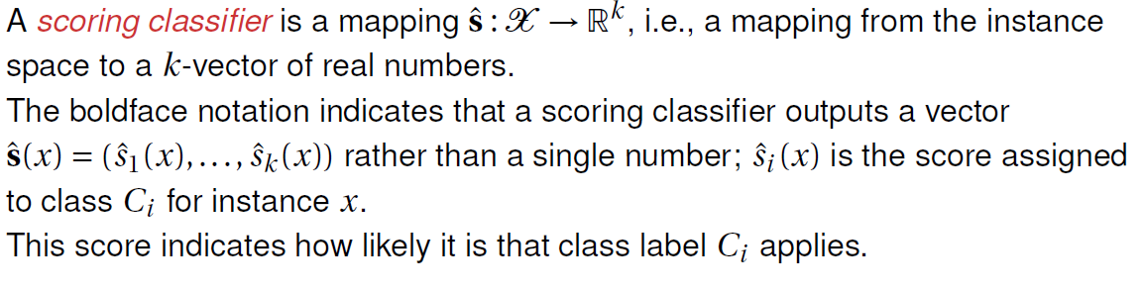
Scoring Classifier
FOR BINARY CLASSIFIER:

Slide 23
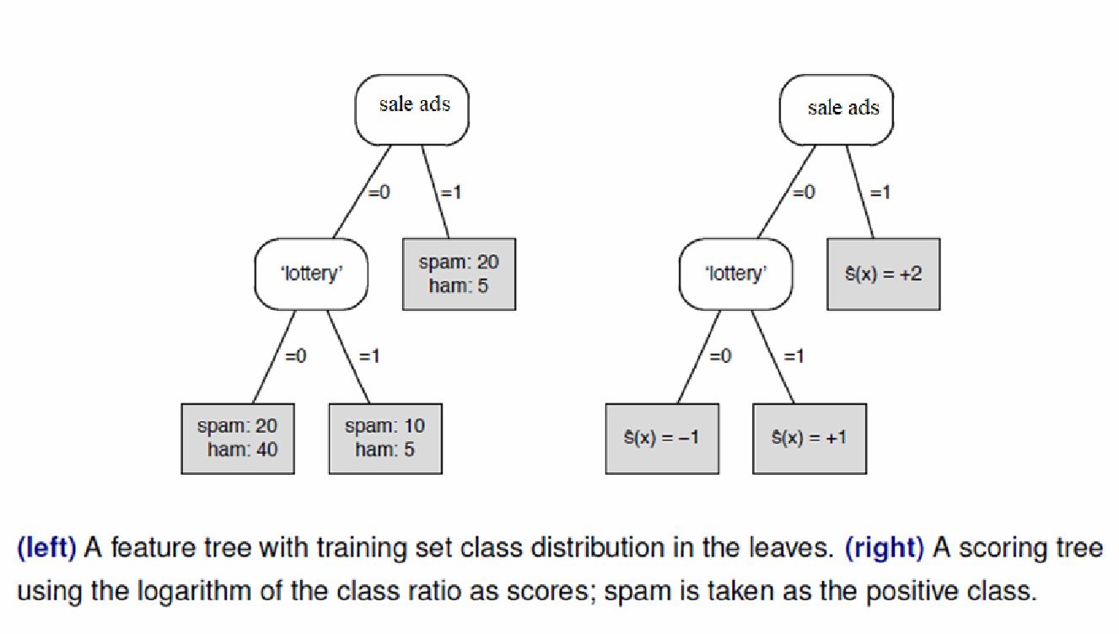
Scoring Classifier

Slide 24
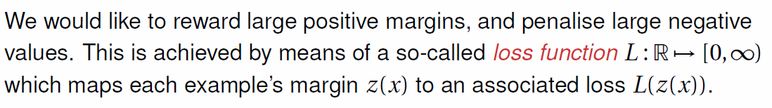
Margins and Loss Function
If we take the true class c(x) as +1 for positive examples and -1 for negative examples, then the quantity z(x) =c(x) *s(x) is positive for correct predictions and negative for incorrect predictions.
The quantity z(x) is called the margin assigned by the scoring classifier.

Slide 25
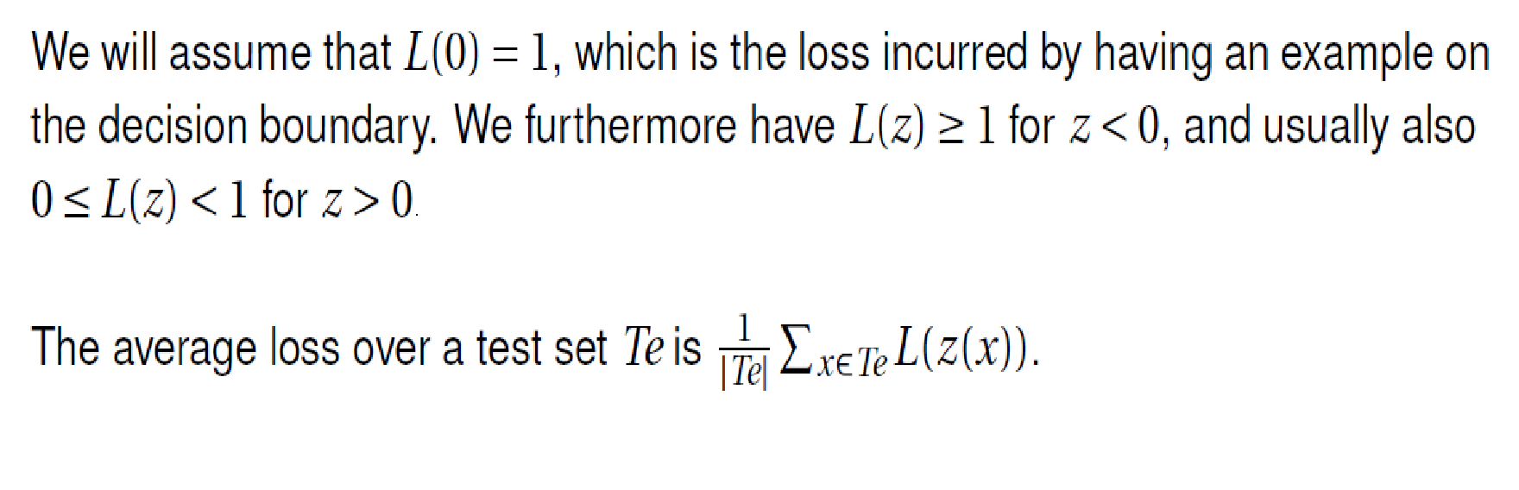
Margins and Loss Function

Slide 26
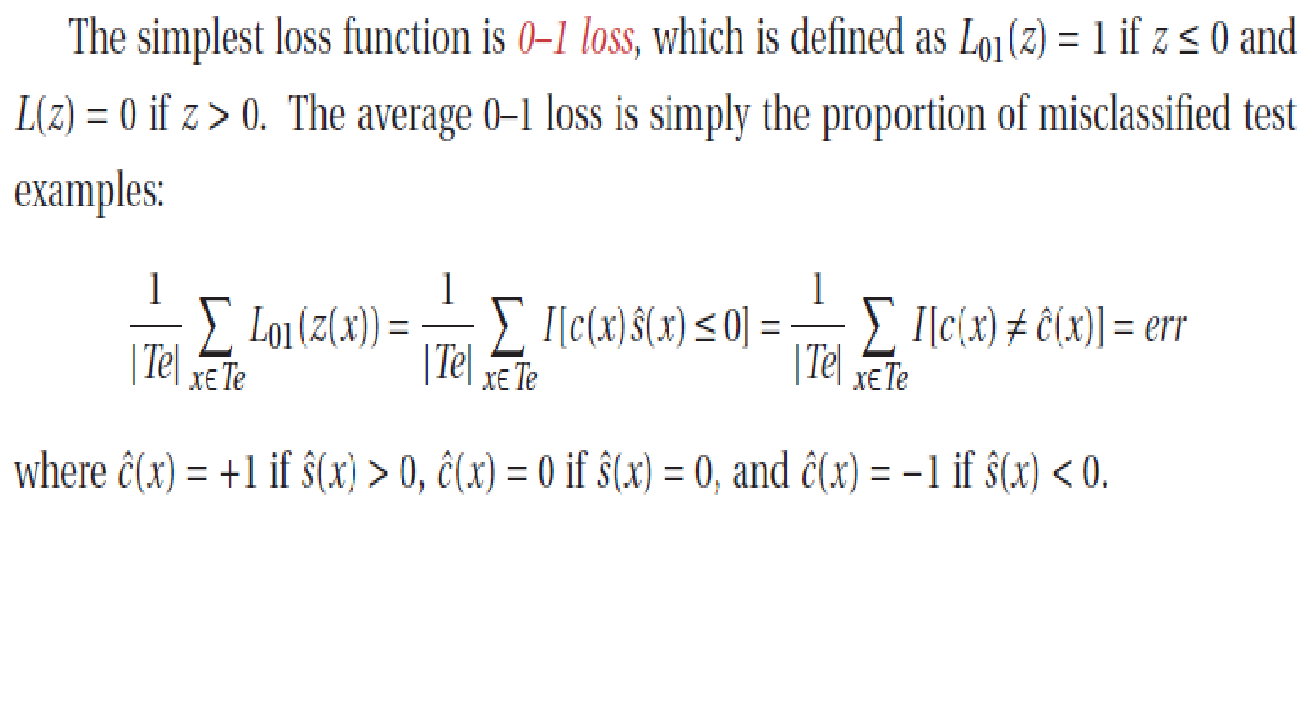
Margins and Loss Function

Slide 27
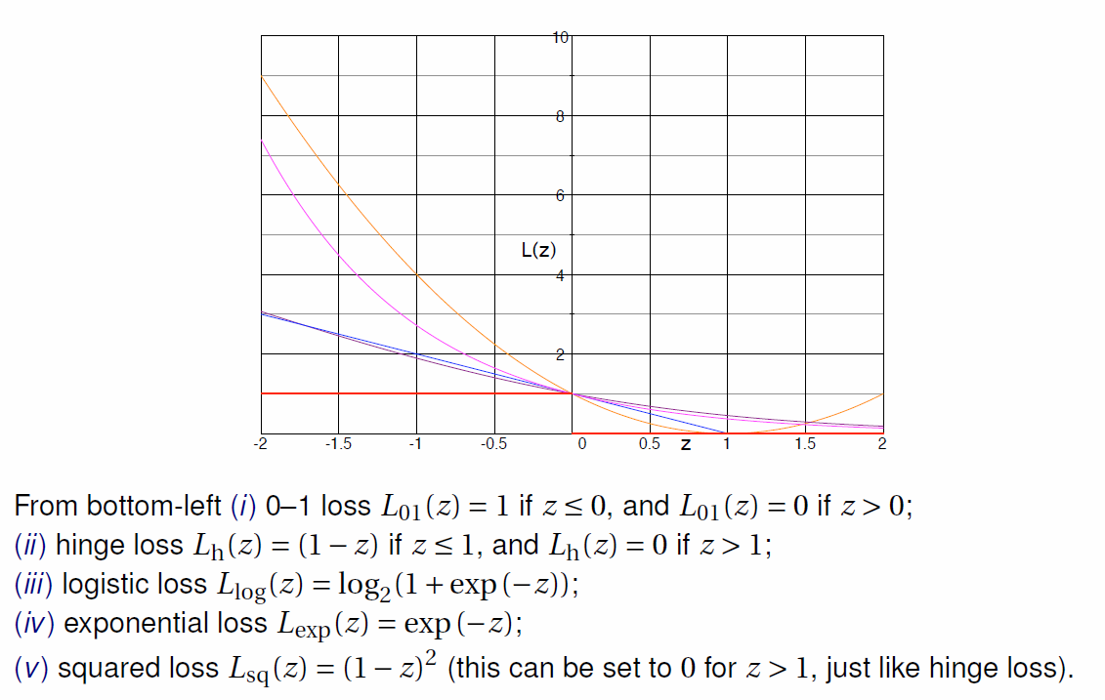
Different Loss Functions

Slide 28
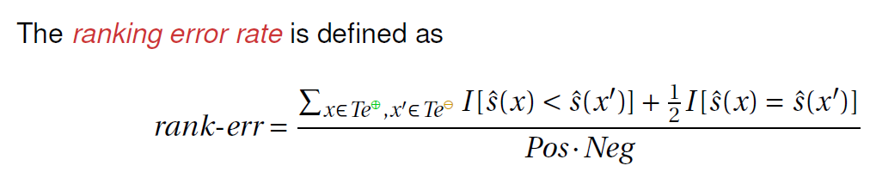
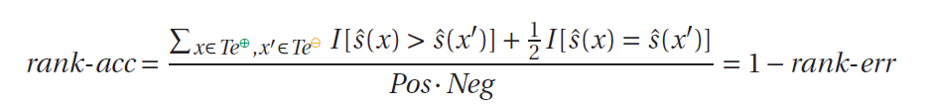
Ranking Error and Ranking Accuracy
Suppose x and x’ are two instances such that x receives a lower score:
ˆs(x) < ˆs(x’).
Higher scores express a stronger belief that the instance in question is positive.
For the case if x is an actual positive and x’ is an actual negative, the expression is wrong.
This is called as Ranking Error

Slide 29
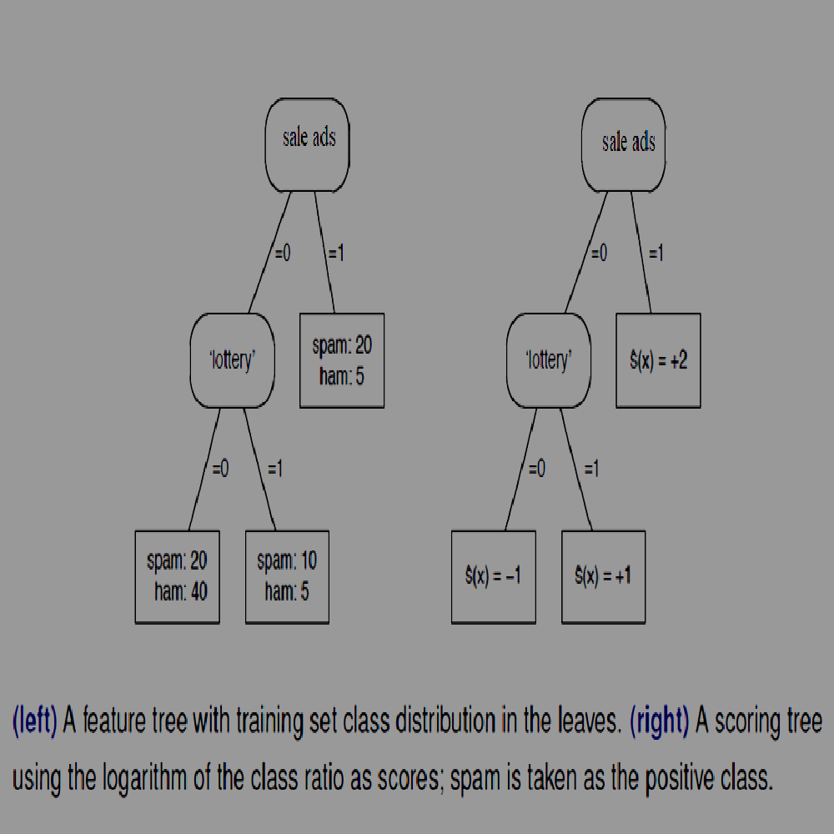

Example for ranking error
The 5 negatives in the right leaf are scored higher than the 10 positives in the middle leaf and the 20 positives in the left leaf, resulting in 50+100 = 150 ranking errors.
The 5 negatives in the middle leaf are scored higher than the 20 positives in the left leaf, giving a further 100 ranking errors.
In addition, the left leaf makes 800 half ranking errors (because 20 positives and 40 negatives get the same score), the middle leaf 50 and the right leaf 100.
In total we have 725 ranking errors out of a possible 50 * 50 = 2500, corresponding to a ranking error rate of 29% or a ranking accuracy of 71%.

Slide 30
Coverage Plot and ROC Plot
The coverage plots and ROC plots which are used for visualizing classifier performance also used for visualizing ranking performance too.
If Pos positives and Neg negatives are plotted on the vertical and horizontal axes, respectively, then each positive–negative pair occupies a unique ‘cell’ in this plot.
If we order the positives and negatives on decreasing score, i.e., examples with higher scores are closer to the origin, then we can clearly distinguish the correctly ranked pairs at the bottom right, the ranking errors at the top left, and the ties in between.

Slide 31
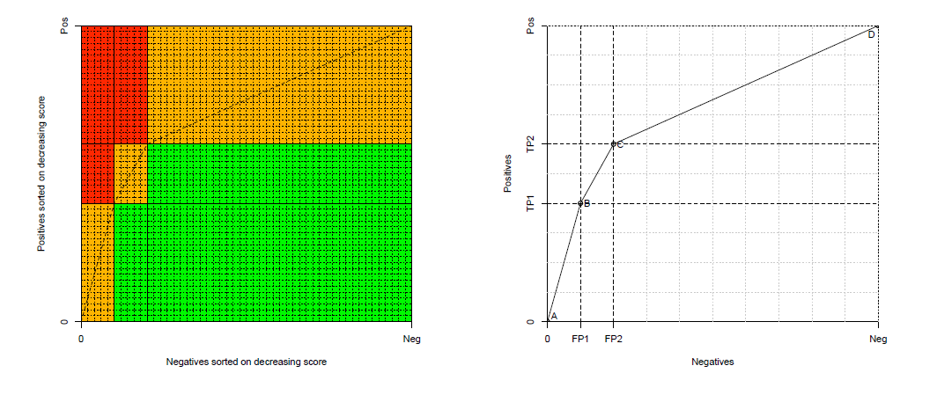
Coverage Curve and ROC Curve

Slide 32
Class imbalance
Suppose we feed the scoring with an additional batch of 50 negatives.
The added negatives happen to be identical to the original ones, so the net effect is that the number of negatives in each leaf doubles.
As a result the coverage curve changes (because the class ratio changes).
but the ROC curve stays the same.
Note that the ranking accuracy stays the same as well: while the classifier makes twice as many ranking errors, there are also twice as many positive–negative pairs, so the ranking error rate doesn’t change.

Slide 33
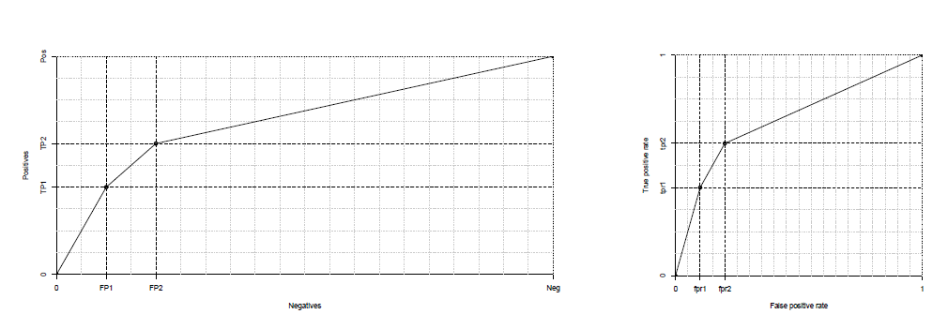
Class Imbalance
(left) A coverage curve obtained from a test set with class ratio clr =1/2.
(right) The corresponding (axis-normalised) ROC curve is the same as the one corresponding to the coverage curve.
The ranking accuracy is the Area Under the ROC Curve (AUC).

Slide 34
Topics
Classification
Scoring and Ranking
Class Probability Estimation

Slide 35
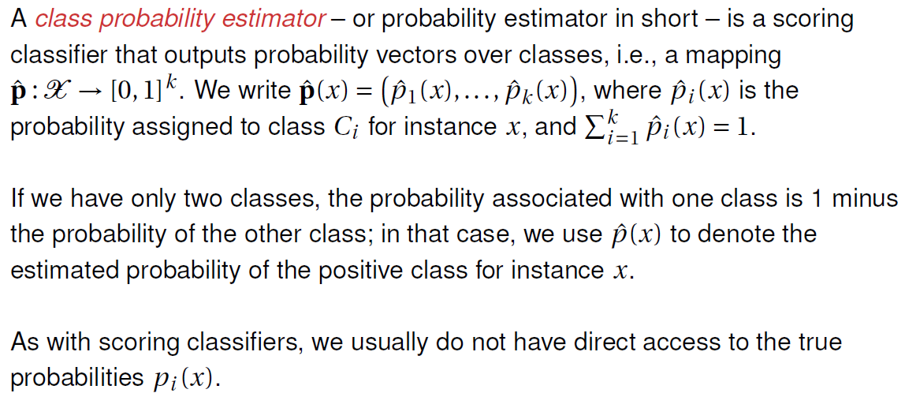
Class Probability Estimation

Slide 36
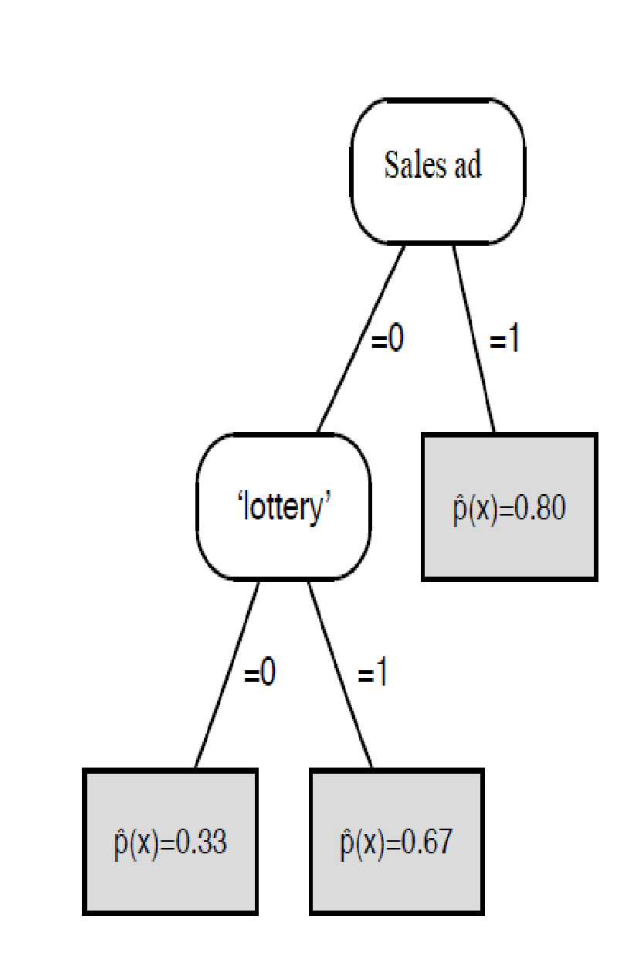
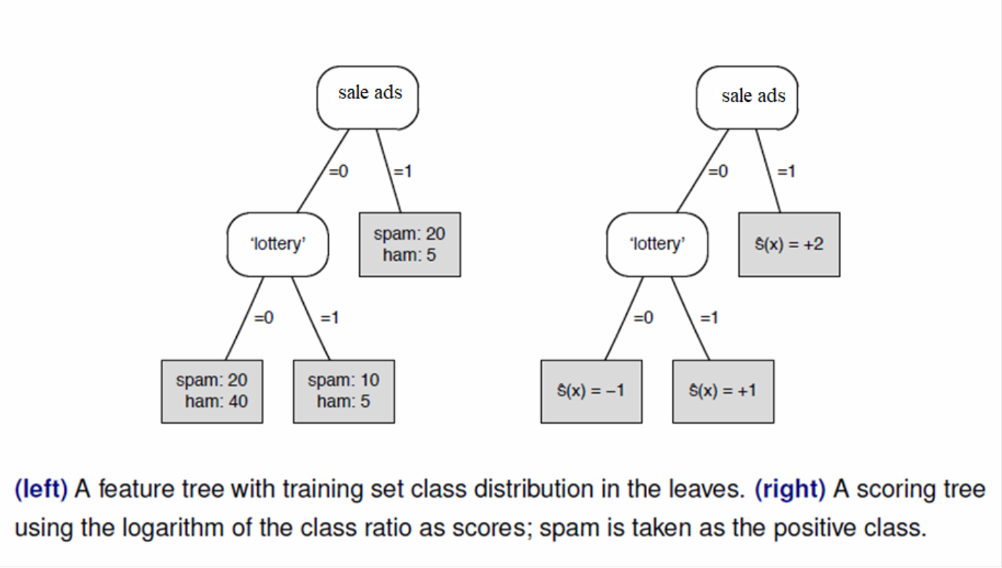
Example

Slide 37
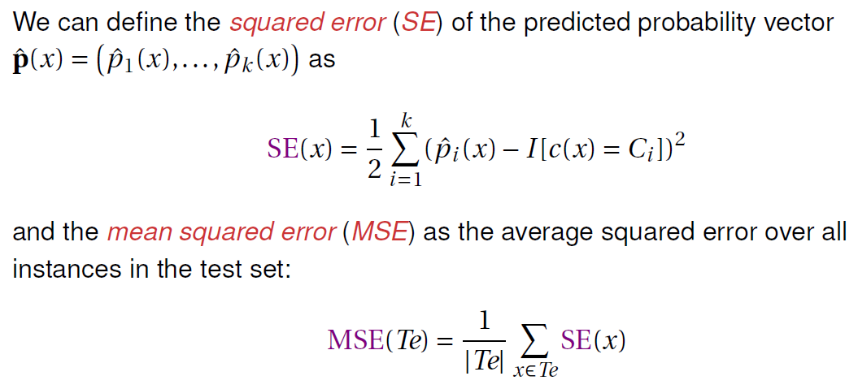
Assessing Class Probability Estimates

Slide 38
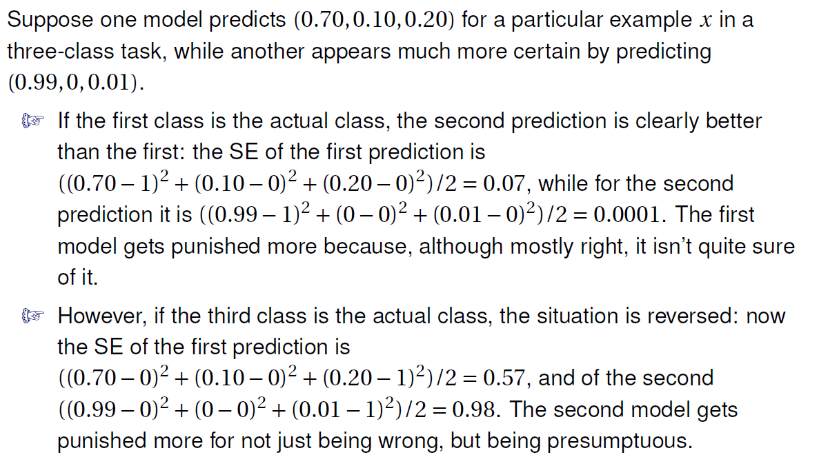
Assessing Class Probability Estimates

Slide 39
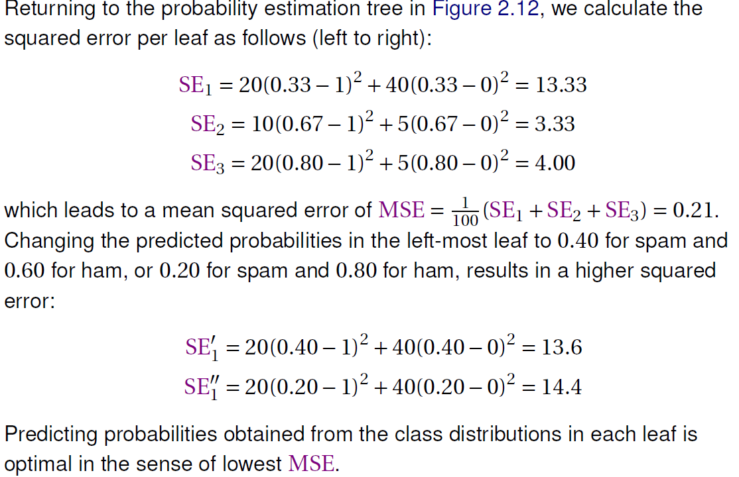
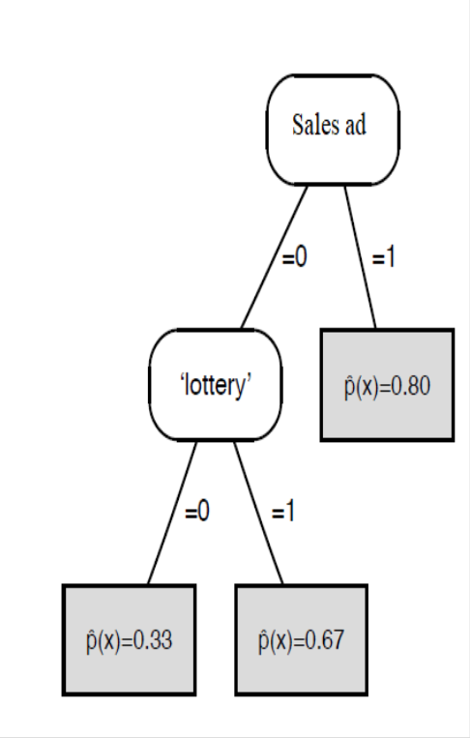
Example for Squared Error

Slide 40
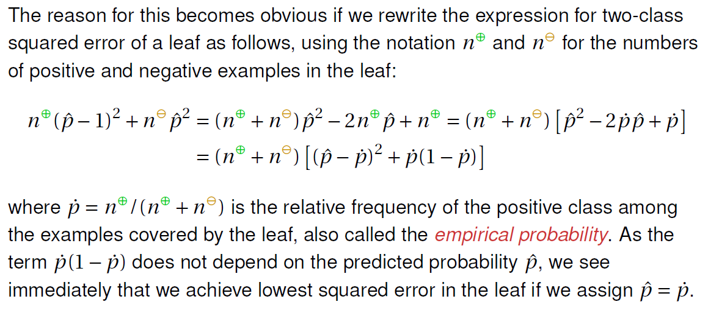
Why predicting empirical probabilities is optimal

Slide 41
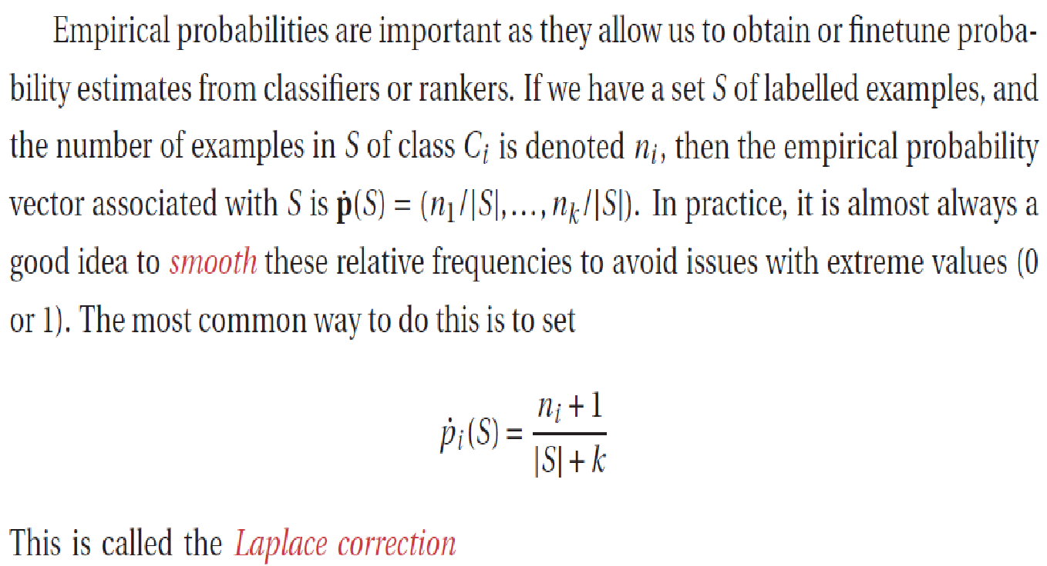
Smoothing empirical probabilities

Slide 42
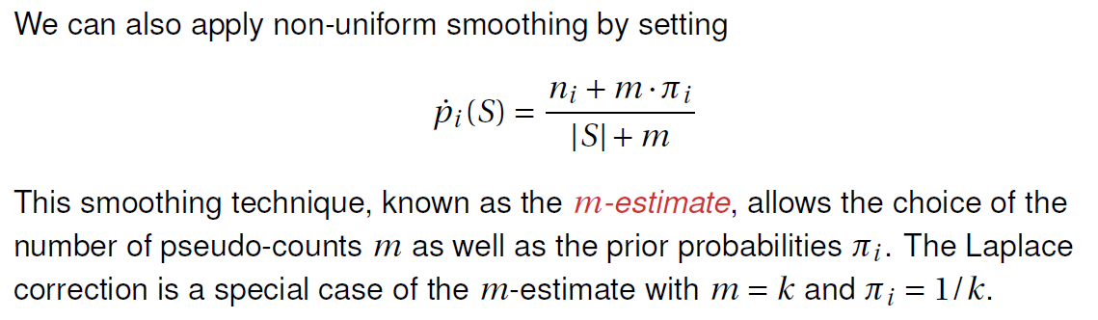
Smoothing empirical probabilities

Slide 43
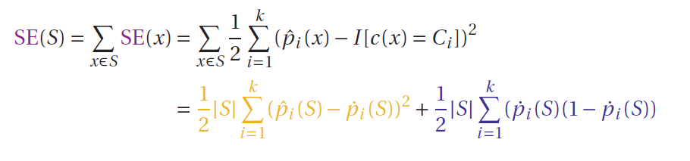
Calibration Loss and Refinement Loss
If all elements of S receive the same predicted probability vector ˆp(S) – which happens if S is a segment of a grouping model – then a similar derivation to the one above allows us to write the total incurred squared error over S in terms of estimated and empirical probabilities as

Slide 44
Calibration Loss and Refinement Loss
The first term of the final expression is called the calibration loss, and measures squared error with respect to the empirical probabilities.
Models with low calibration loss are said to be well calibrated.
The second term is called the refinement loss; this depends only on the empirical probabilities, and is smaller if they are less uniform.

Slide 45
Topics
Classification
Scoring and Ranking
Class Probability Estimation

